Slide 1
Western Civilization
Chapter 3
Age of the Polis

Slide 2
Archaic Age, 750 – 500 B.C.
In 750, Greece began to develop rapidly
Polis
city-state
Urban center
Created bonds to link individuals to the community
Formal rules of government
Psychological allegiance

Slide 3
Acropolis
Highest point in the city
Citadel; gave protection to citizens
Home of king
Meeting place
Temples
Agora ( marketplace )

Slide 4
Acropolis in Athens

Slide 5
Agora

Slide 6
Citizens began to identify with polis
Citizens participated in the political, religious, economic, and cultural activities of the polis
Created a sense of belonging to a group

Slide 7
Governing System
Before the Archaic Age, there was a king
With the Archaic Age came the oligarchy
Elected from the noble class
Lent their money and talents to the arts, literature, and education
Nobles usually took action to resolve basic problems affecting entire population

Slide 8
Military
Had been dominated by the nobility in the Dark Ages
In 8th century, military was based on phalanx
A massed formation of infantrymen called hoplites (each with a shield, helmet, breastplate, spear, and sword)
Brought more citizens into the military
Emphasized service to the polis, discipline, and purposeful action

Slide 9
Greek Phalanx

Slide 10
Hoplite

Slide 11
In early part of Archaic Age there were economic and social problems
Oligarchy tried to promote overseas settlement, expand trade and industry
Social classes changed as a result
Trade created a wealthy class
Some farmers moved to the city
As people felt more attached to the polis, they demanded greater political participation

Slide 12
Tyrants
When aristocrats governing the polis didn’t want to grant this participation, tyrants arose and took power with the help of the hoplites
Tyrants were backed by the people, to work for the people, and were popular with the people called demos

Slide 13
Tyrants
deposed wealthy nobles who were taxed severely, deprived of land, and driven into exile
deprived nobles of control of political life
created economic opportunities for the demos
beautified cities
increased trade and industry

Slide 14
The end to tyranny came when citizens themselves took control of political life
All citizens were entitled to participate
That did not include women, foreigners, or slaves
minority rule

Slide 15
Daily Life
Agriculture
Most earned their living as farmers
Subsistence farming
Some large farms belonging to nobles

Slide 16
Urban centers
Hub of each polis
Large numbers of people
Tradesmen and artisans
Small shops
Major employer was the government

Slide 17
Greeks worked hard but enjoyed leisure activities and gave service to the polis
They lived rather simply but spent time and money on their polis: buildings, festivals, sculpture, painting
Basic social unit was the family

Slide 18
Family
Immediate family plus a slave or two
Arranged marriages
Bride’s father gave a dowry
Marriage took place when girl was fifteen; boys were a little older
Important to have children to help with workload and to take care of parents in old age
Husbands could divorce wives easily; women could not divorce husband

Slide 19
Athenian Women

Slide 20
Women’s Role Except for those in Sparta
No legal rights
Could not own property
Could not participate in politics
Took care of house and children
Raised daughters to fulfill the same role
Did participate in religious festivals
Usually kept out of sight
Could be prostitutes

Slide 21
Men’s role

Slide 22
Men
Spent little time at home
Performed jobs
Took part in city life
Boys of 7 or 8 began their education in cities: reading, writing, music, physical education
Young men moved to the gymnasia for physical training, athletic competition, and talk

Slide 23
Gymnasia

Slide 24
At the gymnasia older boys acted as role models for younger ones; this was often accompanied by homosexual activity, an accepted activity
Boys also frequented markets, theatres, bordellos, and symposia in private homes
Older youths entered the military, participated in assemblies, and held office
The polis totally encompassed their lives

Slide 25
3 Important Cities
Corinth

Slide 26
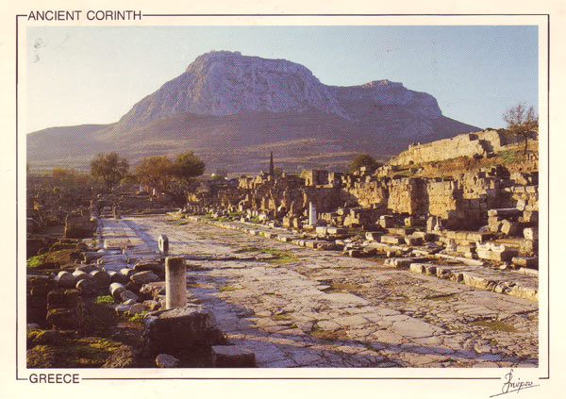
Corinth

Slide 27
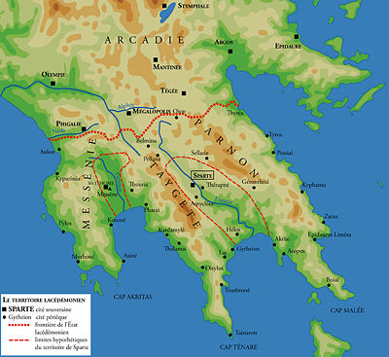
Sparta

Slide 28
Spartan Soldiers

Slide 29
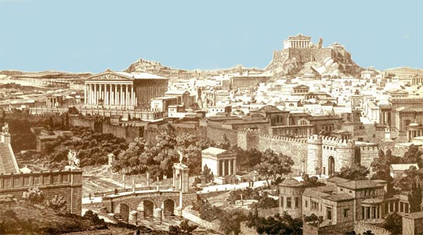
Athens

Slide 30
Acropolis at Athens

Slide 31
Corinth
Prosperous
Favorably located on an isthmus where Peloponnesus meets the mainland of Greece
Good pottery industry
Trade led to colonization of Syracuse and cities in Sicily and Italy to relieve overpopulation and to provide markets
Corinthians also transported goods for others who paid them

Slide 32
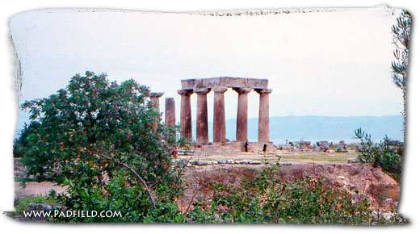
Corinth had an oligarchy and representatives of the demos

Slide 33
Sparta
Had rigid 2-tiered social structure
A warrior class of equals called homoioi
Serfs or helots
They lived in mutual fear and distrust. Warrior class ruled over helots through terror and ritual murder
To other Greeks, Spartans were known for their courage, simplicity of life, and service to the state

Slide 34
War was the center of Spartan life and the origin of their social and political organization
Sparta was the result of a uniting of small agricultural villages
They then conquered their neighbors and forced them to labor for Sparta
Sparta became the largest city-state when they conquered Messenia

Slide 35
Sparta divided their society into 3 classes
Spartans who were considered social equals, the real citizens whose lives were dedicated to soldiering
Perioeci who were traders and manufacturers who made whatever was necessary to maintain the state
Helots who were state slaves who served as laborers on the land or as personal servants

Slide 36
Service to the state was their guiding principle
The state came before family, social class, or occupation
Boys and girls were raised differently

Slide 37
Boys
Birth to 7 Years: they live with their mothers
7 Years: they enter state education system where they live in barracks and have 13 years of rigorous military training; they are taught to endure pain and to win battles
12 Years: they train with swords and spears, have few clothes and a meager diet
Older warriors taught younger boys and took them as homosexual lovers; that was the norm

Slide 38
20 Years: they were sent to finishing school for killers; they were given a cloak and a knife and couldn’t return until they had killed a helot
30 Years: they were incorporated into the ranks of equals when they passed their last test which was to provide food from their own lands for the communal dining group

Slide 39
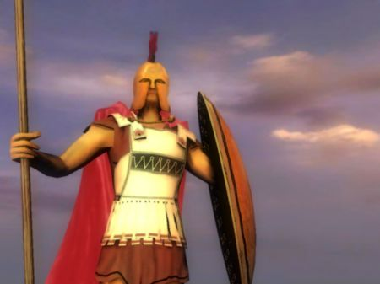
After becoming an equal, they could marry by abducting their brides
Occasionally thereafter, the equal would leave his group of warriors to sleep with her

Slide 40
Spartan Girls

Slide 41
Girls
Trained as athletes; competed naked as wrestlers, foot races, and spear throwing
This training was to improve their ability to have children
Women could own land and businesses
They looked after economic and household affairs because the men were involved in the military

Slide 42
Sparta joined in non-aggression pacts with other cities; example: Peloponnesian League

Slide 43
Athens

Slide 44
Mycenaean Age: it was a fortress center controlling an area called Attica
Dark Age: life in Attica was primitive and made up of a small number of independent agricultural villages with clan leadership
Archaic Age: villages became one unit centered around Athens; there was a hereditary king, an Areopagus (council of clan heads), and an Ecclesia (a popular assembly)

Slide 45
750 B.C.: hereditary monarchy was abolished
An Archon king elected annually
Areopagus consisted of ex-Archons
In 621 B.C. Draco, a reformer, drew up a code of law to curtail the power of the aristocracy.
In 594 B.C. Solon, another reformer, became an Archon and aided the poor and oppressed, struck down old debt laws, encouraged new forms of agriculture, promoted trade, manufacturing, and skilled artisans

Slide 46
Solon also:
set up a new coinage system
Broadened the public control of government to check aristocratic abuses of power
This brought on instability because of political rivalries: commoners vs. aristocrats
This led to tyranny

Slide 47
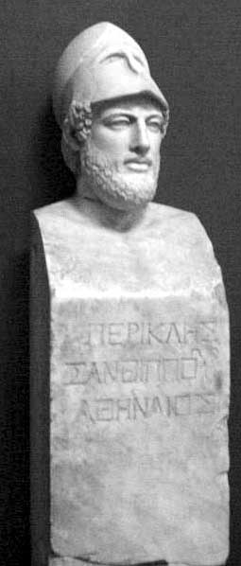
Pisistratus and Sons

Slide 48
Pisistratus and sons (r. 546 – 510 B.C.)
Set up public works programs
Promoted Athenian commerce and industry
Tried to assure a fair distribution of justice
In 510 B.C. tyranny was overthrown by aristocrats like Cleisthenes

Slide 49
Cleisthenes

Slide 50
Cleisthenes (510 – 507 B.C.)
Wanted to establish democracy
Set up a council
Grouped people into 30 territories and they elected members to the council
Aristocrats, merchants, and the poor had to work together for political action
Integrated democracy; whoever fights for the state governs it

Slide 51
Citizens did not include women, foreigners called metics, and slaves
Minority rule in Athens as a result
Participation of citizens was encouraged in politics

Slide 52
By the 6th Century B.C.:
Greek city-states had generally resolved class conflict
Merchants and artisans flourished despite poor soil and an uncertain climate
Greek philosophers, poets, and artists celebrated the human form and the human spirit
By the second half of the 6th century B.C., the Persian empire, ruled by Cyrus II, conquered Lydia, Ionia, and the coast of Asia Minor; they ruled there until 499 B.C.

Slide 53
Cyrus II

Slide 54
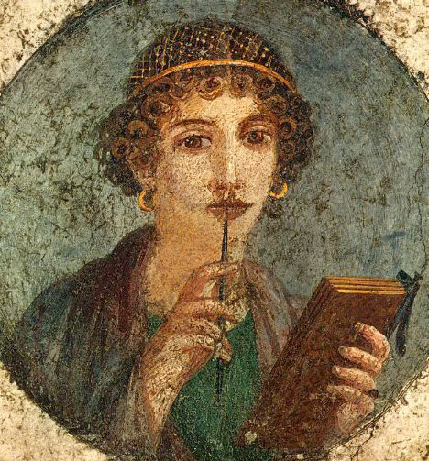
Archaic Greece’s Culture
Poetry
Lyric poetry was dominant 675 – 500 B.C.
Short poems commenting on love and politics
Lyric Poets:
Archilochus of Paros was the earliest known lyric poet who wrote mockingly about love, war, and travel
Sappho of Lesbos wrote about her love for other women

Slide 55
Sculpture:
Displayed interest and skill in creating the human form
Used marble, clay, and bronze
Early statues showed Egyptian influence – rigid
By 6th century B.C., the human form was less rigid and they experimented with different poses
Tried to express the ideal form and idolized youth
Example: Kouros and Kore

Slide 56
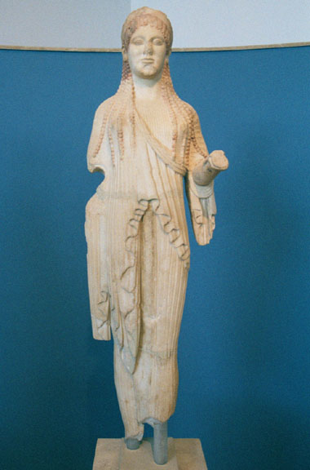
Kouros & Kore

Slide 57
Religion
Olympian gods and goddesses became the gods of the polis
Each polis might pick 1 particular god to honor: Athens -- Athena
Temples were built to honor them
Faced east to catch sunlight
Decorated on outside more than on the inside
Temple contains a treasury room facing west and a main chamber with a statue of the god being honored
Roof, painted sculptures, & columns

Slide 58
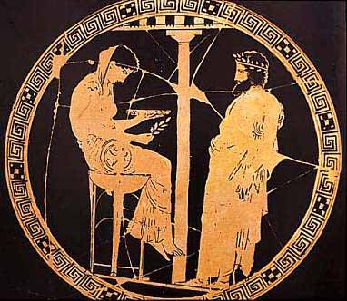
Oracle at Delphi

Slide 59
At Delphi, one consulted a god for advice about the economy, war, and government decisions
The religion said not to be arrogant or evil. There will be a punishment for that

Slide 60
Philosophy
Abstract and rational thinking emerged during 6th century B.C. in Miletus in Ionia
They were the first Greeks to move away from divine explanations
Thales: predicted a solar eclipse in 585 B.C.. He founded Greek geometry and astronomy. He believed water was the primary substance from which nature was created

Slide 61
Thales

Slide 62
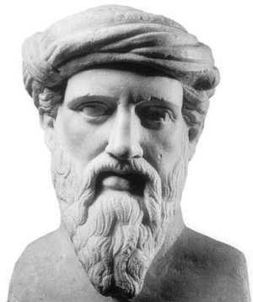
Anaximander said the primary substance was undefined
Heracleitus said fire was the primary substance
Pythagoras was a mathematician who worked with ratios and the musical scale; also founded a religious community

Slide 63
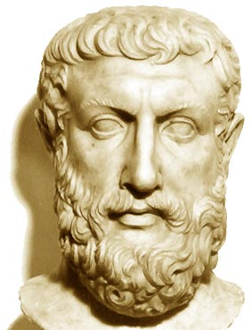
Parmenides distrusted the senses and said change was an illusion; the world of senses and reality are very different

Slide 64
Classical Greece
Demokratia
the power of the people in Athens in the 5th century B.C.
Elections mattered less than direct participation
Citizenship was restricted
Emphasized freedom, equality, citizenship without having to own property
Citizens could run for office and must respect the law

Slide 65
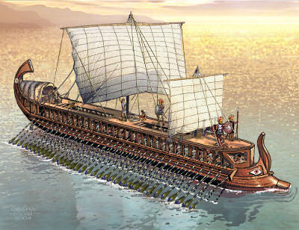
In 480s when Greece was threatened by Persia, there was a saying: Whoever fights for the state governs it.
Athens built a navy based on the trireme

Slide 66
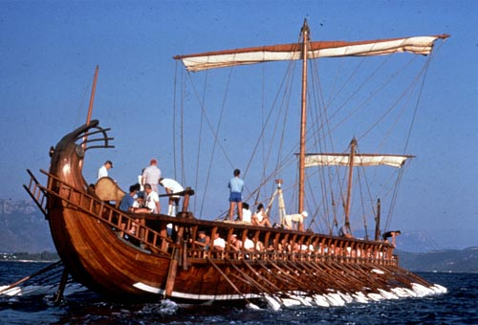
Trireme was a warship rowed by 170 men on 3 decks

Slide 67
500 B.C., Sparta was still the leader of the Peloponnesian League
499B.C., Ionian cities that Cyrus II of the Persian Empire had conquered revolted and sent to Athens and Eritrea for help
They sent ships to help their Ionian neighbors
Persians sent a large force under King Darius, Cyrus’ successor, to recapture the rebellious cities

Slide 68
Darius

Slide 69
The war lasted 5 years
Persia won
Punishment for rebellious cities was severe
Darius wished to punish Athens and Eritrea for helping the rebellious cities
The Greeks weren’t unified enough to give an effective defense
Some Greeks even saw Persians as potential allies

Slide 70
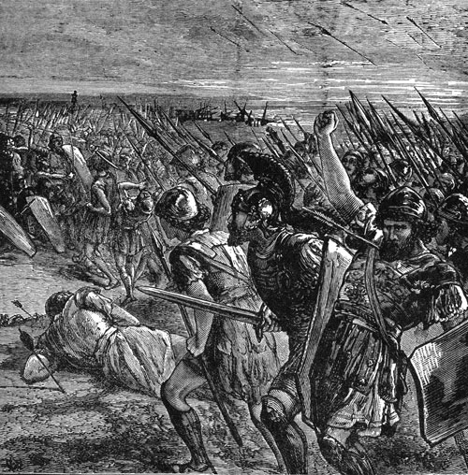
In 490 B.C., Darius I captured Eritrea and sent its people into captivity
Then he moved on to Marathon and was surrounded by Greeks

Slide 71
Battle of Marathon
Greeks were led by Miltiades who had served Darius at one time
He knew Persian strengths and weaknesses
Hoplite phalanxes rushed down from the hills surrounding the Marathon plains and enveloped the Persian army
6,000 Persians died
Fewer than 200 Athenians died

Slide 72
Persia retreated to their ships thinking they could attack Athens itself before word of the defeat reached the city and before hoplite forces could return to the city
Athenians ran 23 miles back to the city of Athens and arrived before the Persian fleet
So the Persians returned home without a fight

Slide 73
Victory at marathon was important for 3 reasons:
It showed that a citizen army was superior to the Persian army
Greeks felt they were then superior to all invaders
Victory enhanced the democratic reforms of Cleisthenes

Slide 74
Ostracism
After the victory common citizens wanted to be sure that aristocrats didn’t take back power from the demos
So they began the practice of ostracism
This was a 10-year exile without loss of property for those who tried to take away some of the power of the people
Each year the people would cast their ballots.
The man with the most votes would be ostracized

Slide 75
The Ballots

Slide 76
War with Persia - Again
Persians struck again
Xerxes, son of Darius, wanted to extend the western border of the Persian Empire
Sparta was to command the land and sea forces for the Greeks
City-states pooled their armies and their navies
Spartans fought hard against the Persians at Thermopylae

Slide 77
Thermopylae

Slide 78
Greeks at Thermopylae

Slide 79
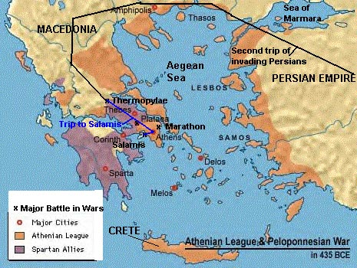
Persians then moved on to Athens and burned it
Then they lost at the Battle of Salamis and Xerxes went home

Slide 80
By 479 B.C., Sparta no longer wished to fight so far from home
There were too many internal problems within the league
Athens stepped in to take the lead and formed the Delian League in 478 B.C.
They continued to fight the Persians
A peace treaty was signed with Persia in 449 B.C.

Slide 81
Delian League
Around 465 B.C., Athens began to change the league into its own empire -- with great difficulty
Athens became wealthy off the league
It used league money to rebuild Athens when the money was supposed to be used by all the member city-states
These actions threatened the Greek institution of autonomous city-states

Slide 82
Anti-Athenian feelings arose and members looked to Sparta for help
The result was the Peloponnesian War lasting off and on from 431 – 404 B.C.

Slide 83
Peloponnesian War
Bloody and bitter
Was accompanied by disease, economic warfare, and blunders : Athens tried to take Sicily and failed losing 200 ships in the process ruining its navy
Persia stepped in to help Sparta
The Athenian Empire was rising in revolt
Persia led a battle against Athens

Slide 84
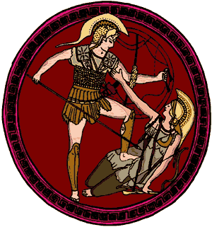
Athens was cut off from supplies and people were starving
In 404 B.C. Athens surrendered
The Athenian Empire and its navy were destroyed

Slide 86
Culture of Classical Greece
Classical means to set a standard
The culture of Greece from 480 to 322 B.C. has so influenced the West, it has been deemed Classical
Greek culture is really Athenian culture
Even during political changes and war, there were still rational discussions being held in the agora, the courts, and at symposia

Slide 87
They were no longer relying on myths to explain the mysteries of life
They examined the past and questioned the foundations of their traditions
The result of all this enquiry was a developing moral philosophy and history
They looked for rational explanations of the universe

Slide 88
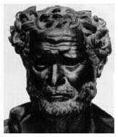
They examined the powers and limitations of the mind
Heraclitus searched for an inner understanding that would lead to proper action in society

Slide 89
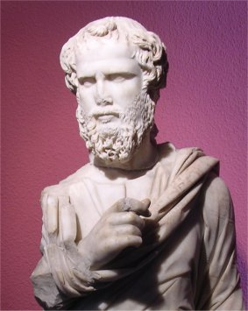
They learned to formulate arguments using logic
Sophists went around the countryside teaching others the art of persuasion, a skill needed in democracy

Slide 90
Other Philosophers
Socrates (470-399B.C.)
he searched for moral self-enlightenment
“Know thyself”
Through discussion, he would get others to defend their views and often found they couldn’t
Questioning
Socratic method
He was skeptical of religion
Public believed he was not pious

Slide 91
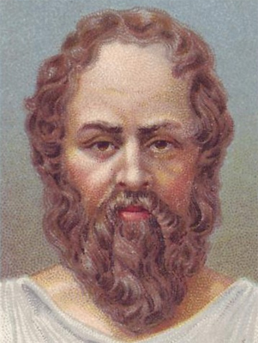
Socrates was condemned to death for corrupting the morals of youth in 399 B.C.
He had a chance to go into exile but chose death because he said he accepted Athenian law
He drank hemlock

Slide 92
Plato (428 – 347) B.C.
student of Socrates
Grew up during Peloponnesian War
Experienced democracy and imperialism in Greece and other forms of government in Sicily and Italy
Opened the Academy in Athens in 387 B.C.
Taught others through dialogue and discussion
Said fundamental realities in universe are called ideas; the chief idea is the “good”

Slide 93
Said humans are a pale image of what they could be
Justice consists in each person doing what he or she is best suited for
Failures of governments result from ignorance of the truth
Wrote down Socrates teachings
Plato wrote The Republic

Slide 95
Aristotle (384-322 B.C.)
Student of Plato
Tutor of Alexander the Great
Taught at the Lyceum
Said every object has some purpose in the universe
Said the state is the natural grouping of humans for the purpose of promoting Virtue

Slide 96
Aristotle

Slide 97
Art
Human Image
Shown in pottery
Black-figure pottery
Red-figure pottery
Showed muscle tone of body and clothing
Wanted to show the ideal human form

Slide 98
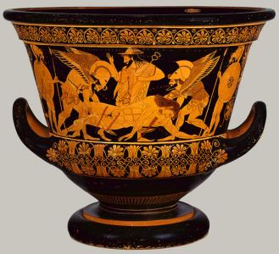
Red-figure Pottery

Slide 99
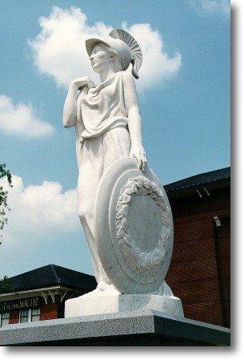
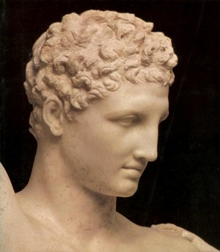
Sculpture
Reflected balance and realism
Showed the ideal form
Used bronze and marble

Slide 100
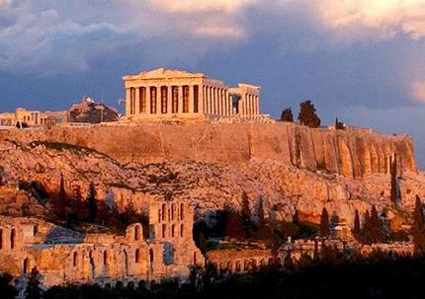
Architecture
5th century B.C., Athenians rebuilt the Acropolis

Slide 101
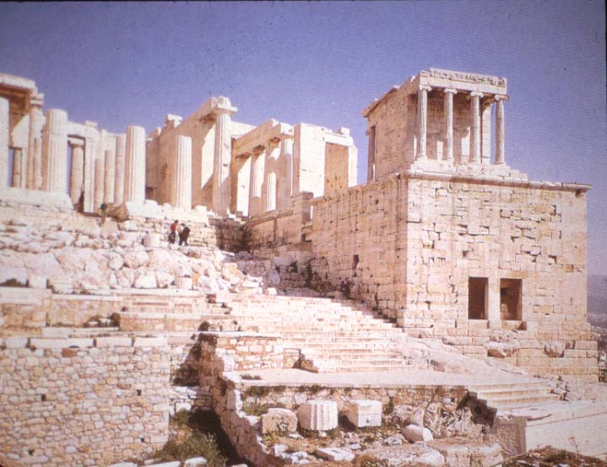
You entered through the gateway called the Propylea

Slide 102
Propylea

Slide 103
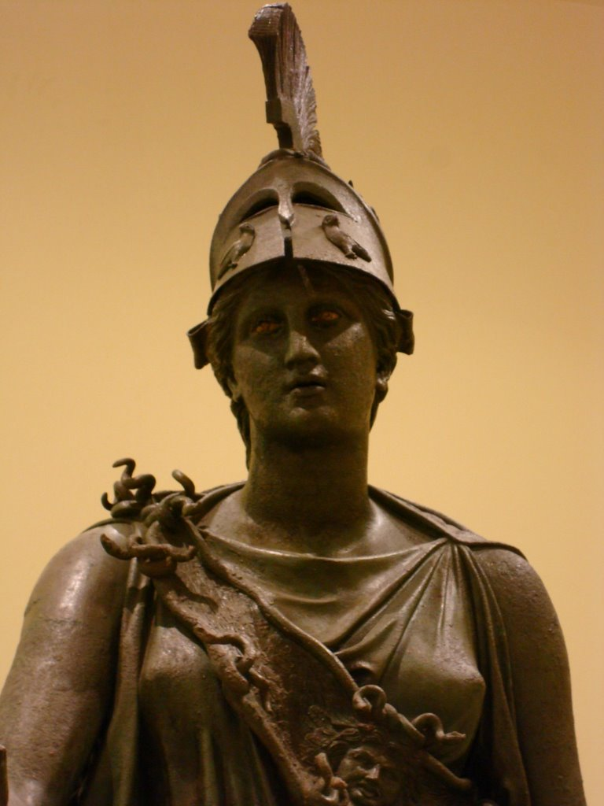
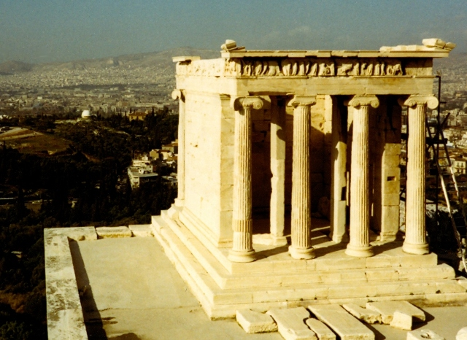
At the top of the stairs, one sees a statue of Athena and a small temple to Athena

Slide 104
Parthenon

Slide 105
Doric Columns

Slide 106
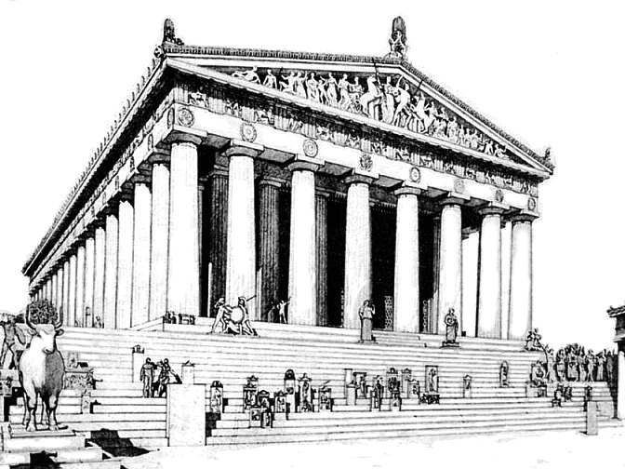
Doric

Slide 107
Erechtheum

Slide 108
Caryatids

Slide 109
Ionic Column

Slide 110
The Acropolis in Athens gives the impression of a superior Athens; however, 2 years after the Erechtheum was completed, Athens surrendered to Sparta

Slide 111
Athenian Drama
Plays were selected through a contest and would be performed at festivals throughout the year
2 types of plays:
Tragedies
About great men who failed because of a fatal flaw
A moral to the story
Learned to correct flaws

Slide 112
Comedies
Topical and political
A take-off on real happenings and real people; poked fun at situations
Amused audience while making a serious point
Plays became more and more secular and showed the human condition. Only a few plays from the 5th century have survived.

Slide 113
Aeschylus wrote tragedies and stressed endurance and that one should bear punishment with dignity; example – Orestia
Sophocles also wrote tragedies and stressed endurance and the acceptance of responsibility; example – Antigone
Euripedes posed questions about human values; Medea

Slide 114
Aristophanes wrote comedies where he mocked and ridiculed politicians, artists, democratic institutions, and Athenian social mores; example - Lysistrata

Slide 115
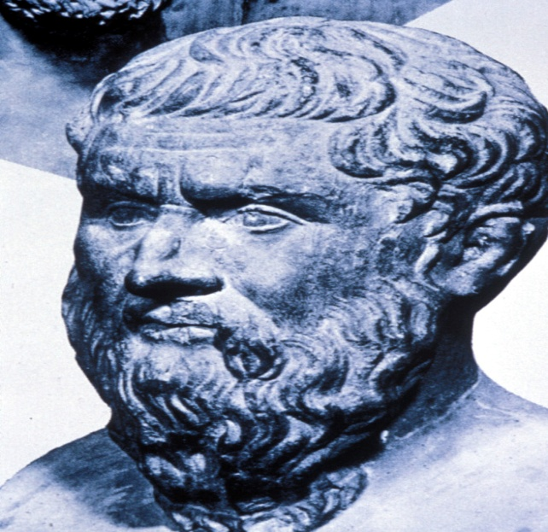
History
Herodotus
Historical writer
The first historian
Wrote about Persian wars
Wrote about the rise and fall of empires

Slide 116
Thucydides was a historian who also wrote about the Persian wars
He wished to be accurate
Wrote about events he had lived through
He was a failed Athenian general who spent most of the Peloponnesian War in exile
His theme was how disastrous war is on the human soul

