Slide 1

Prebid Meeting
Community Education and Performing Arts Center

Slide 2
Agenda
Introductions
Project Overview
Project Scope of Work
General Conditions
Technical Requirements
Items of Note
Walk Through
Scope Questions
Contract Process & Award
Questions

Slide 3
Project Team
Kathy Meagher
  Director of Campus Facilities, Project Manager
Scott Cryer
  DLR Group, Architect, Construction Administrator
Randy Bittinger
  VP of Administrative & Financial Services
Hugh Schrier
  Plant Manager
Eric Swearengen
  Plant Systems Supervisor / Chief Electrician
Chris Jones
  Facilities Administrative Associate

Slide 4
Project Overview
First Performing Arts Center to Garrett County
Community Education Center
State and Locally Funded Project
Community Partnerships
    Garrett County
    Board of Education
    Garrett Lakes Arts Festival (GLAF)
    Garrett County Arts Council
Notes:
Workforce Development
Continuing Education

Slide 5
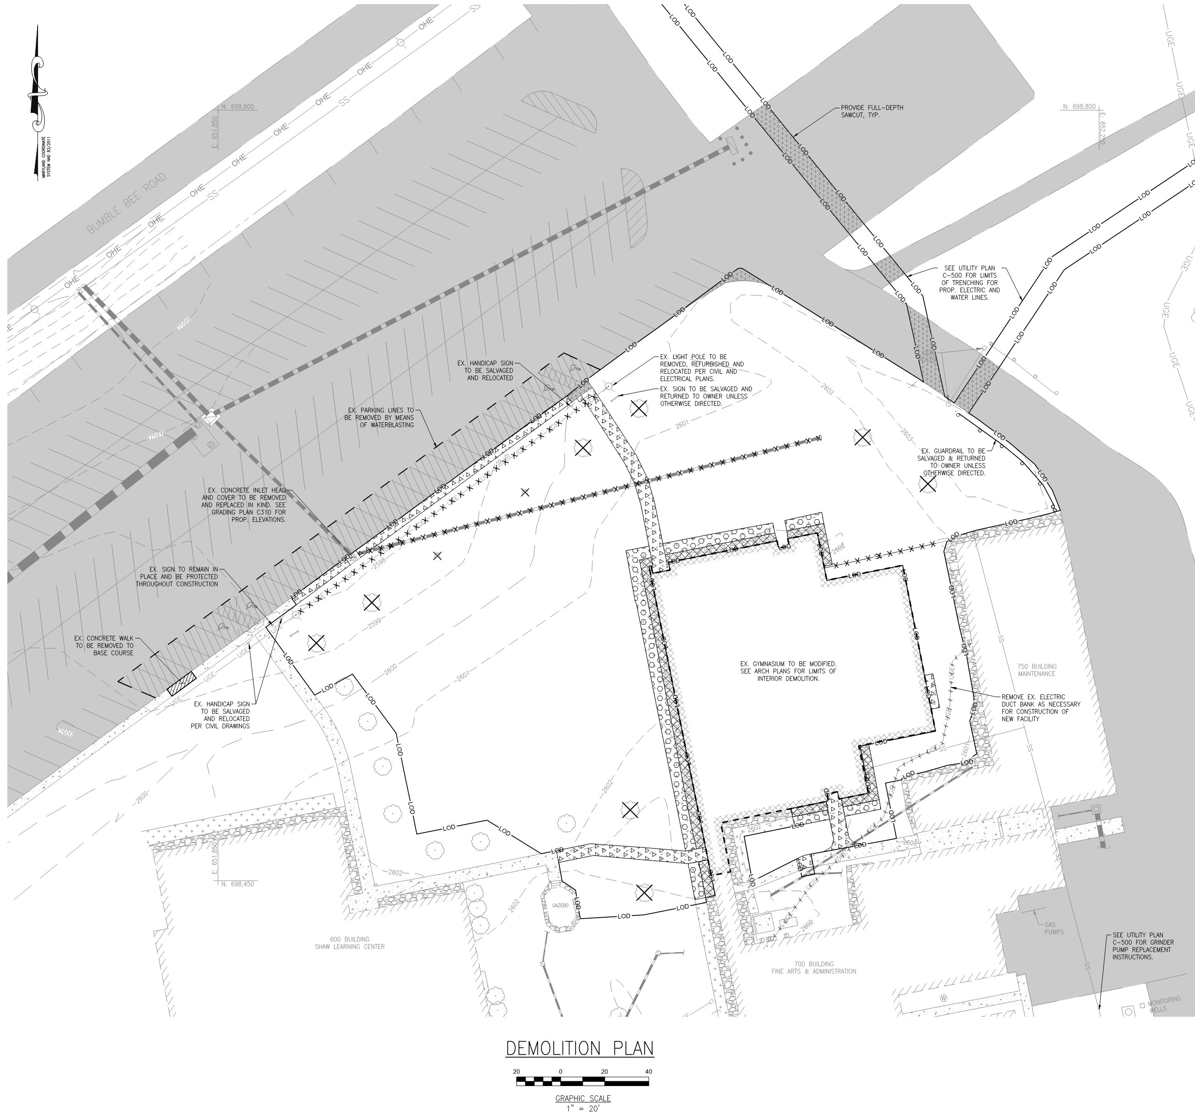
Scope of Work

Slide 6
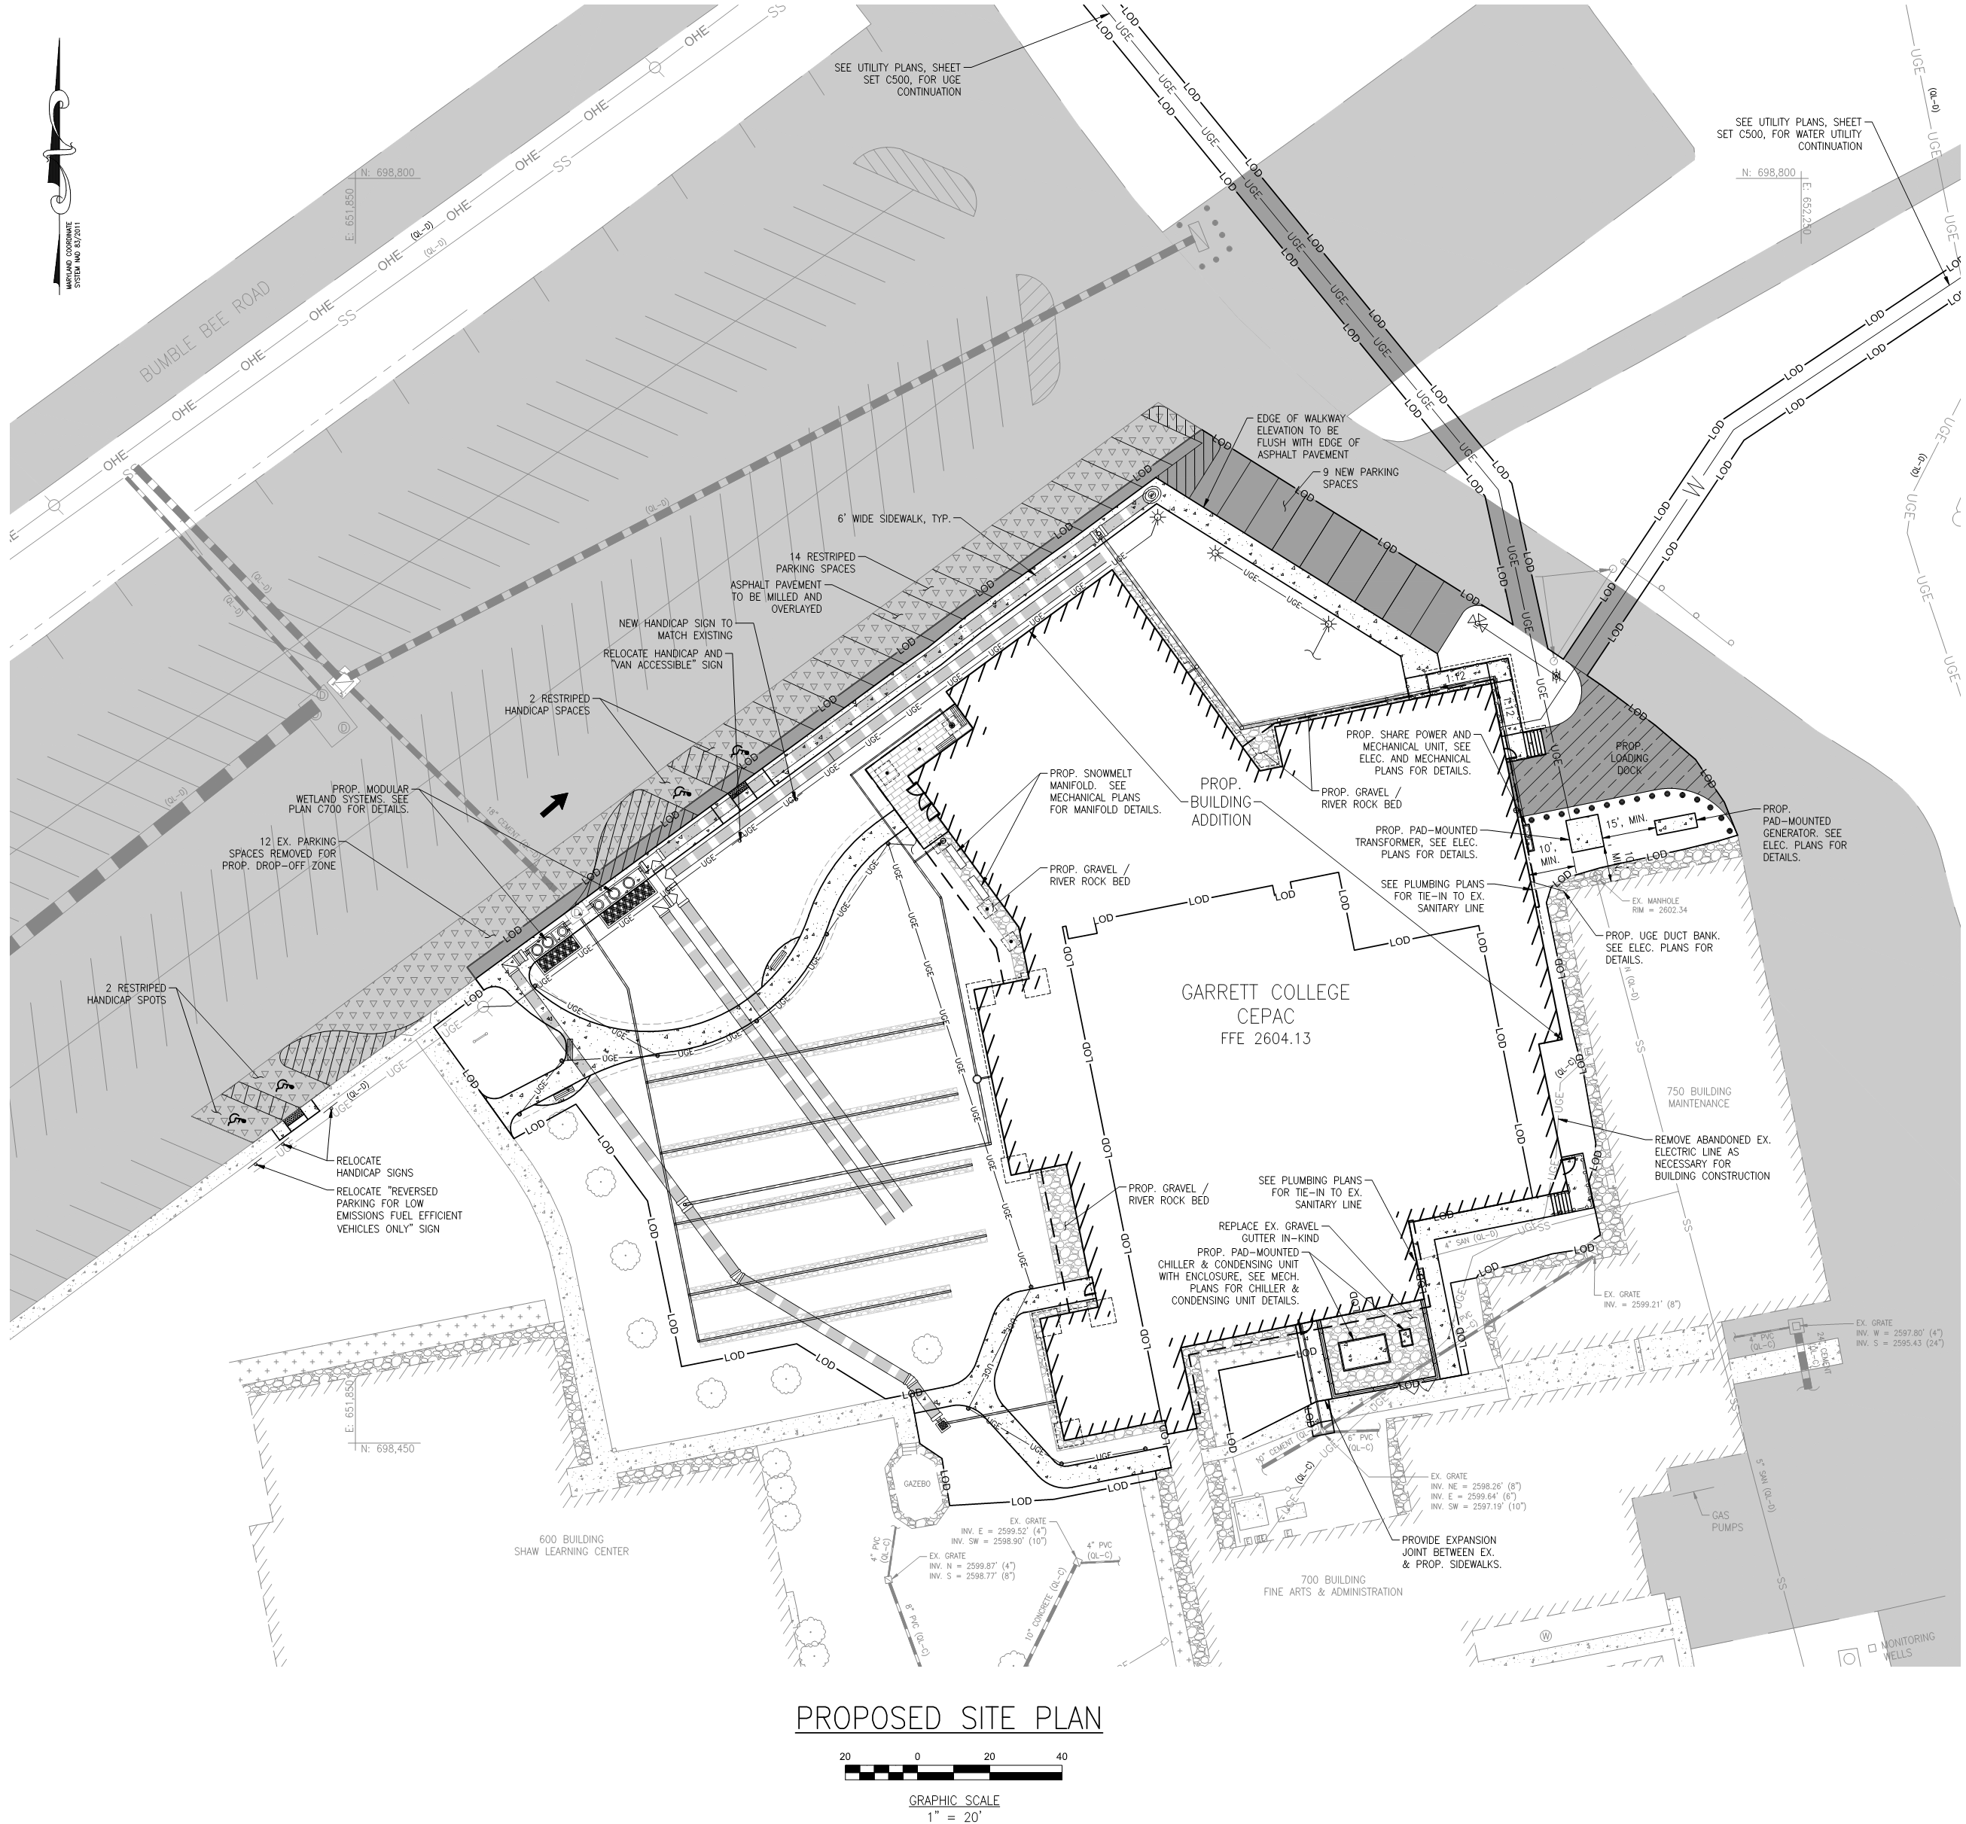
Scope of Work

Slide 7
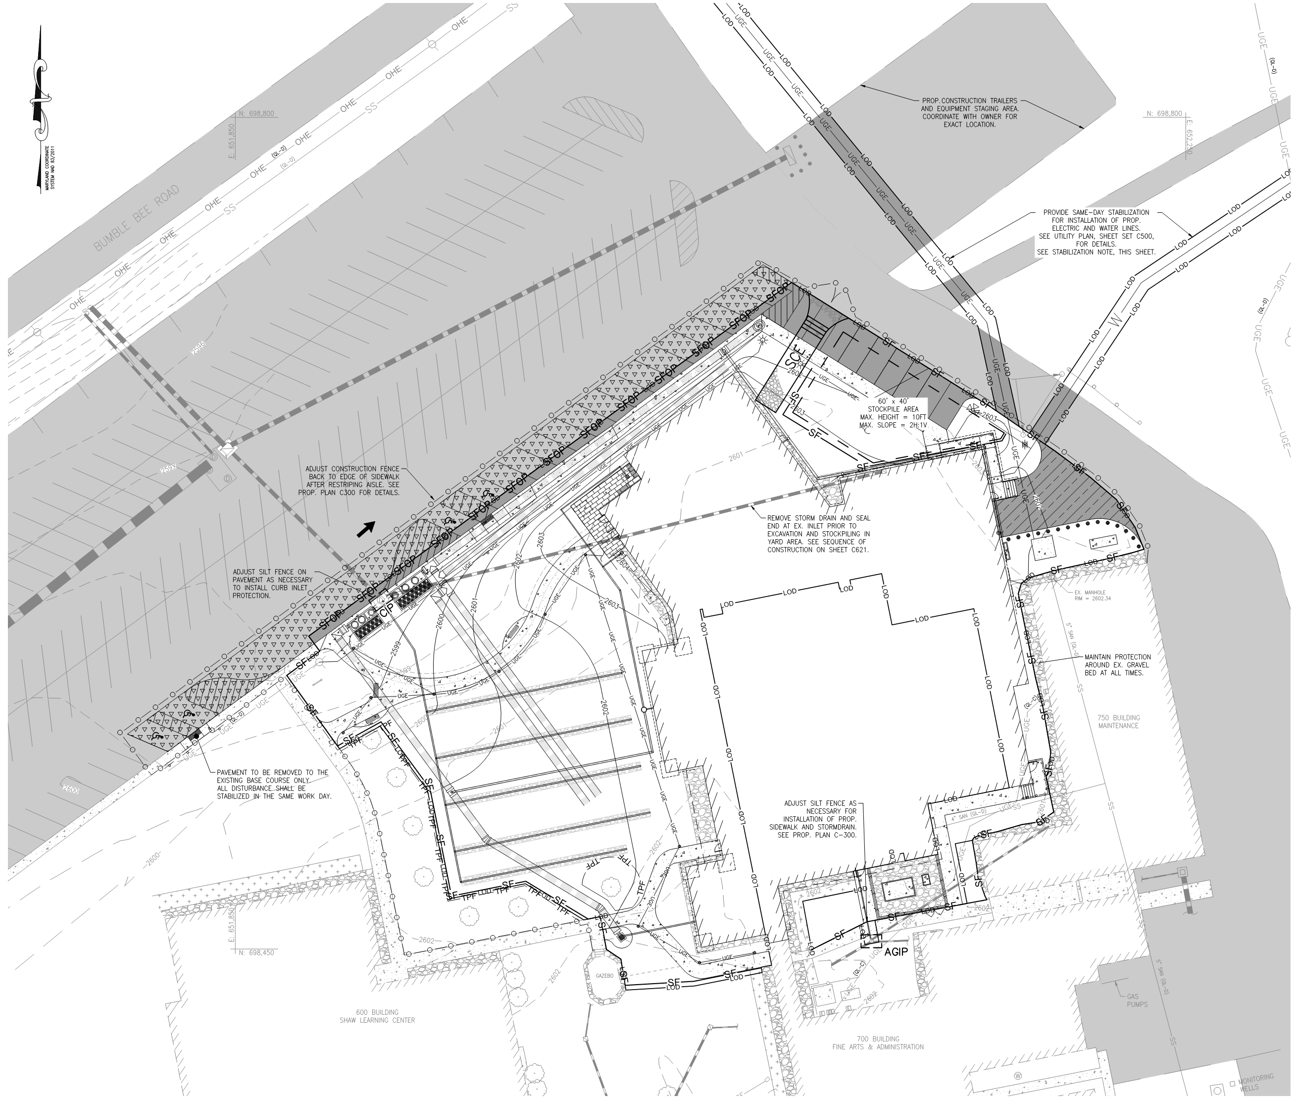
Scope of Work

Slide 8
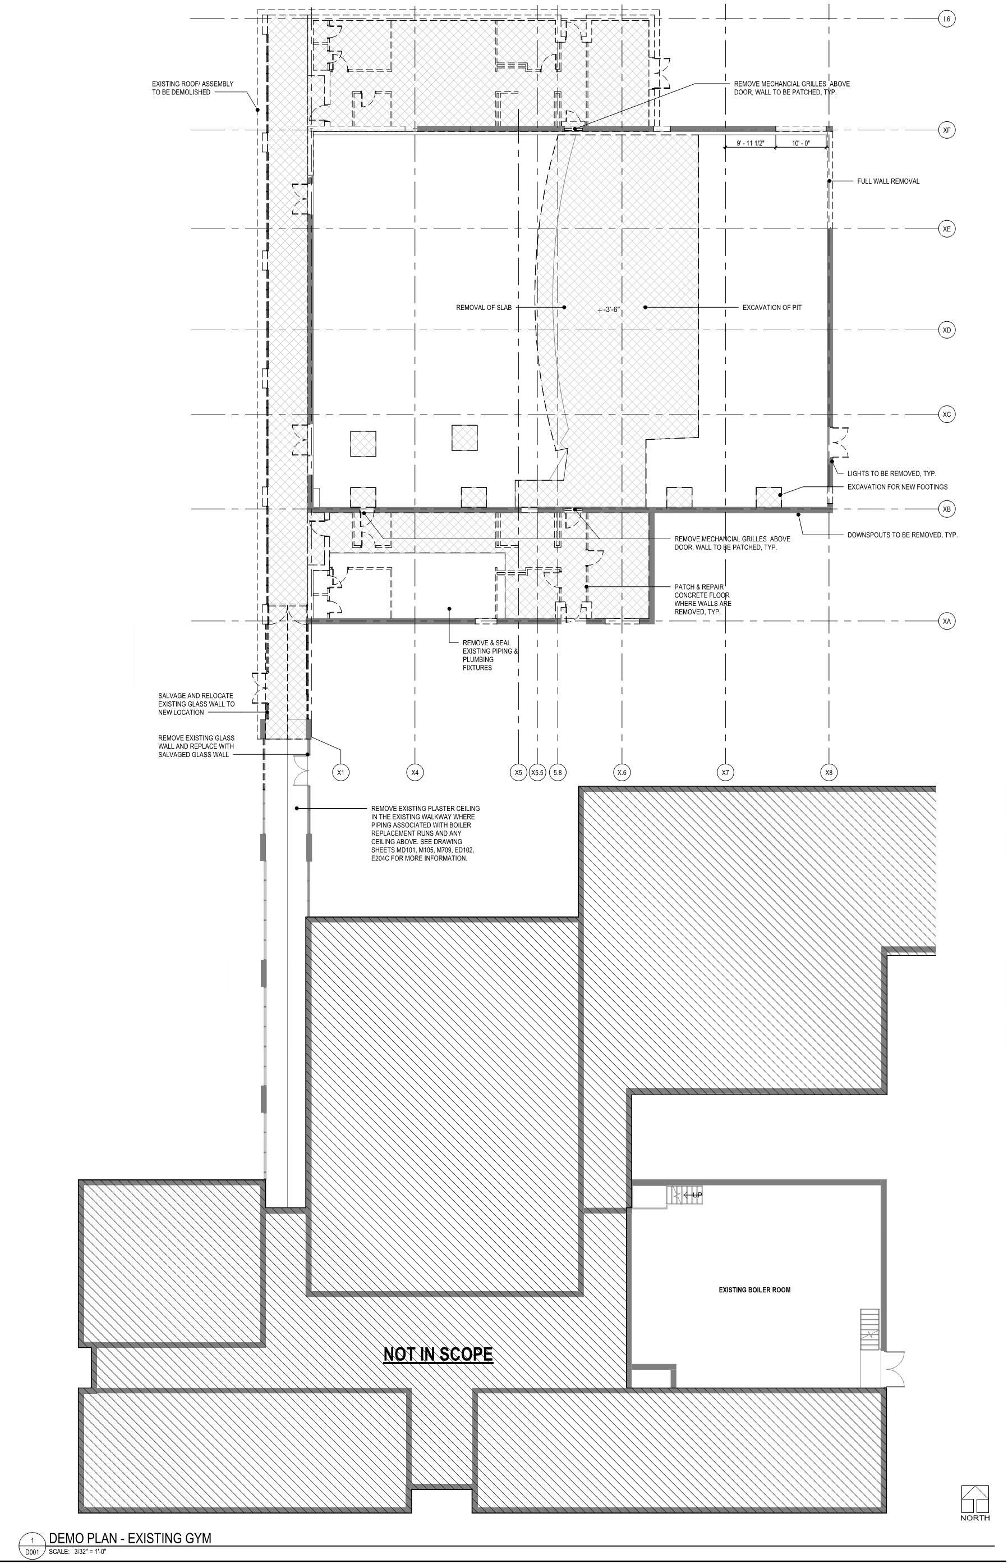
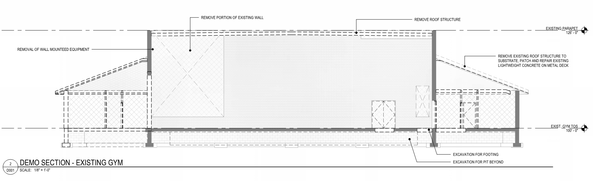
Scope of Work

Slide 9
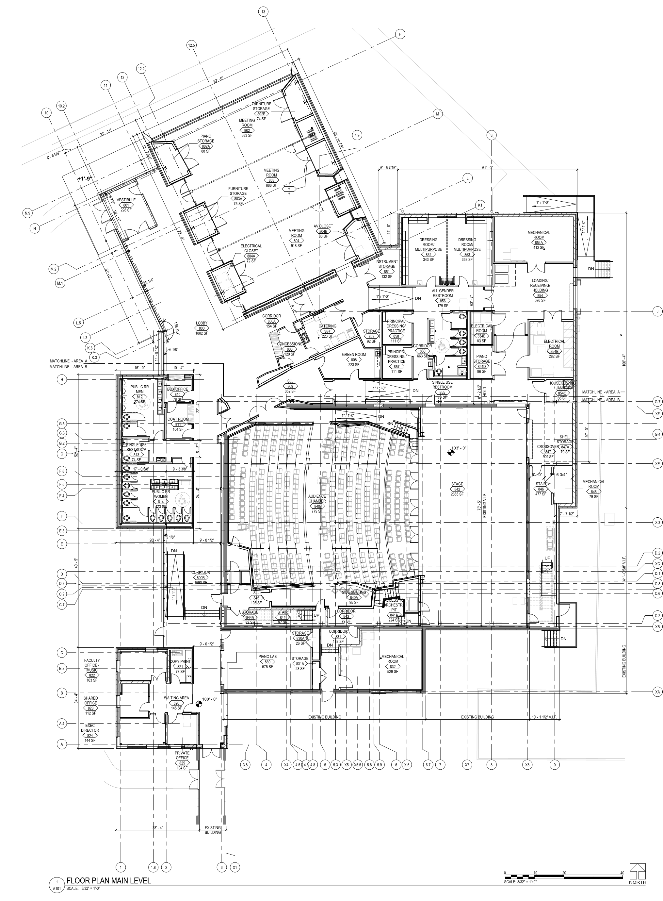
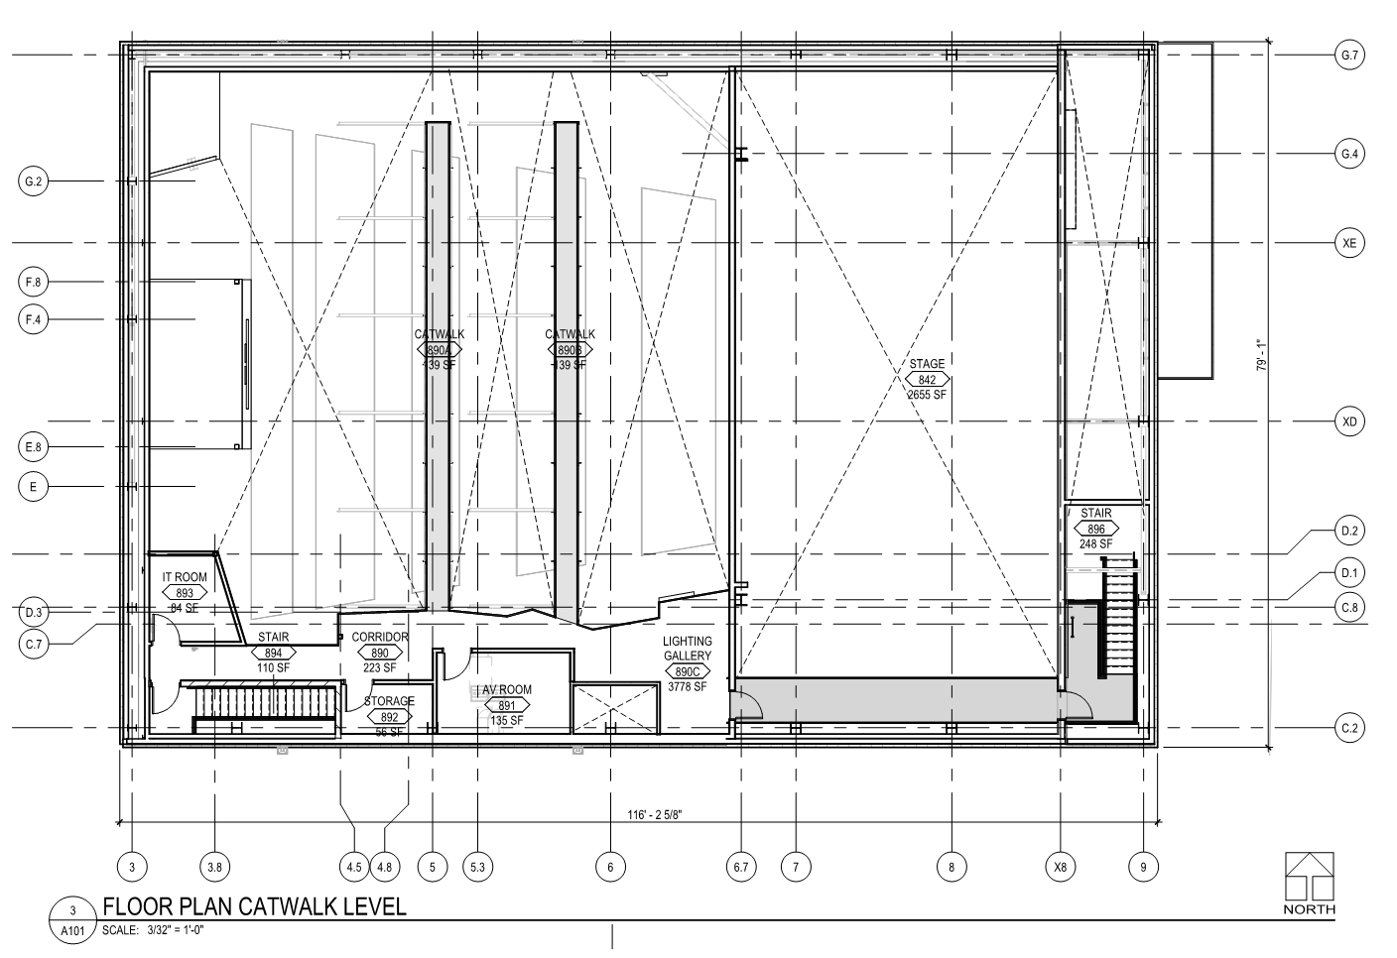
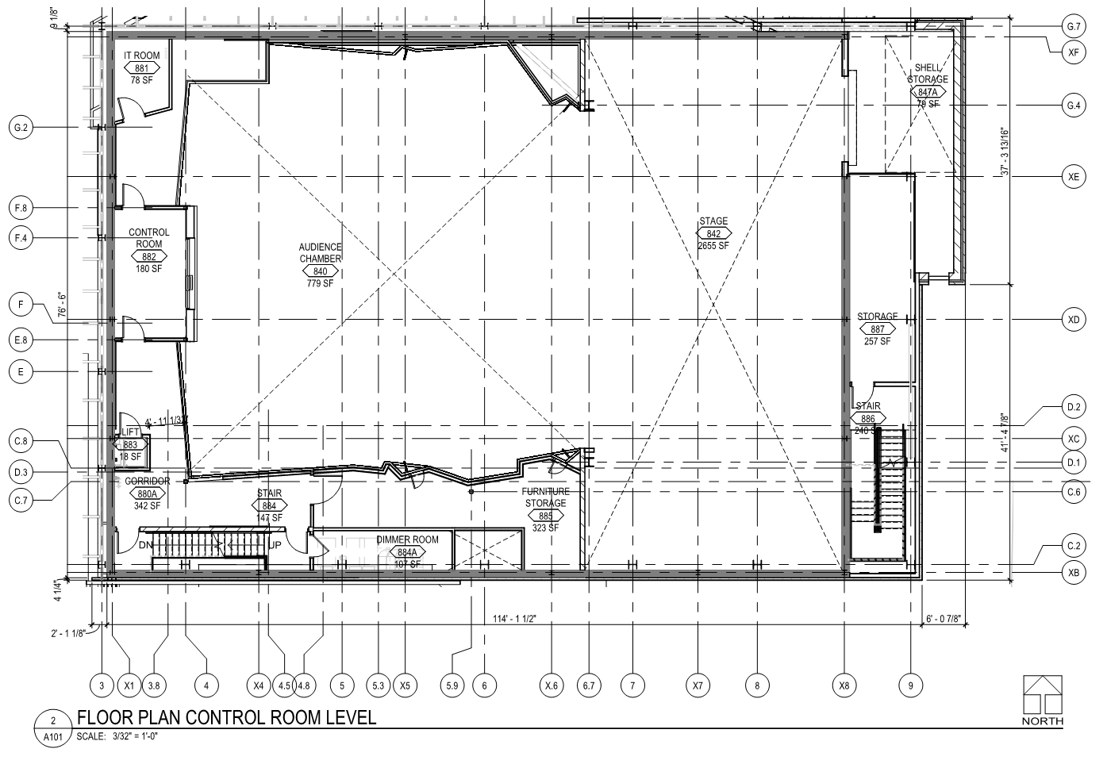
Scope of Work

Slide 10
General Conditions
Alternates
Informational Prices
  Boiler Replacement
  Emergency Generator
Johnson Controls / Metasys
MBE Target

Slide 11
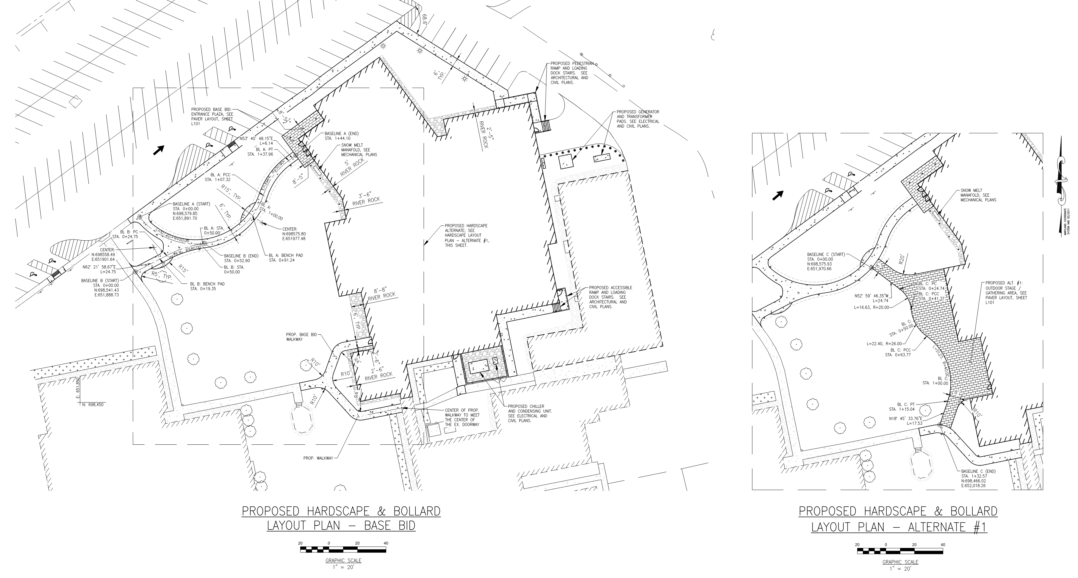
General Conditions – Alternate 1

Slide 12
General Conditions – Alternate 2

Slide 13
General Conditions – Alternate 2

Slide 14
Informational Price – Boiler Replacement

Slide 16
Informational Price – Emergency Generator

Slide 17
Technical Requirements
Theatrical & AV Coordination
LEED v4
Commissioning

Slide 18
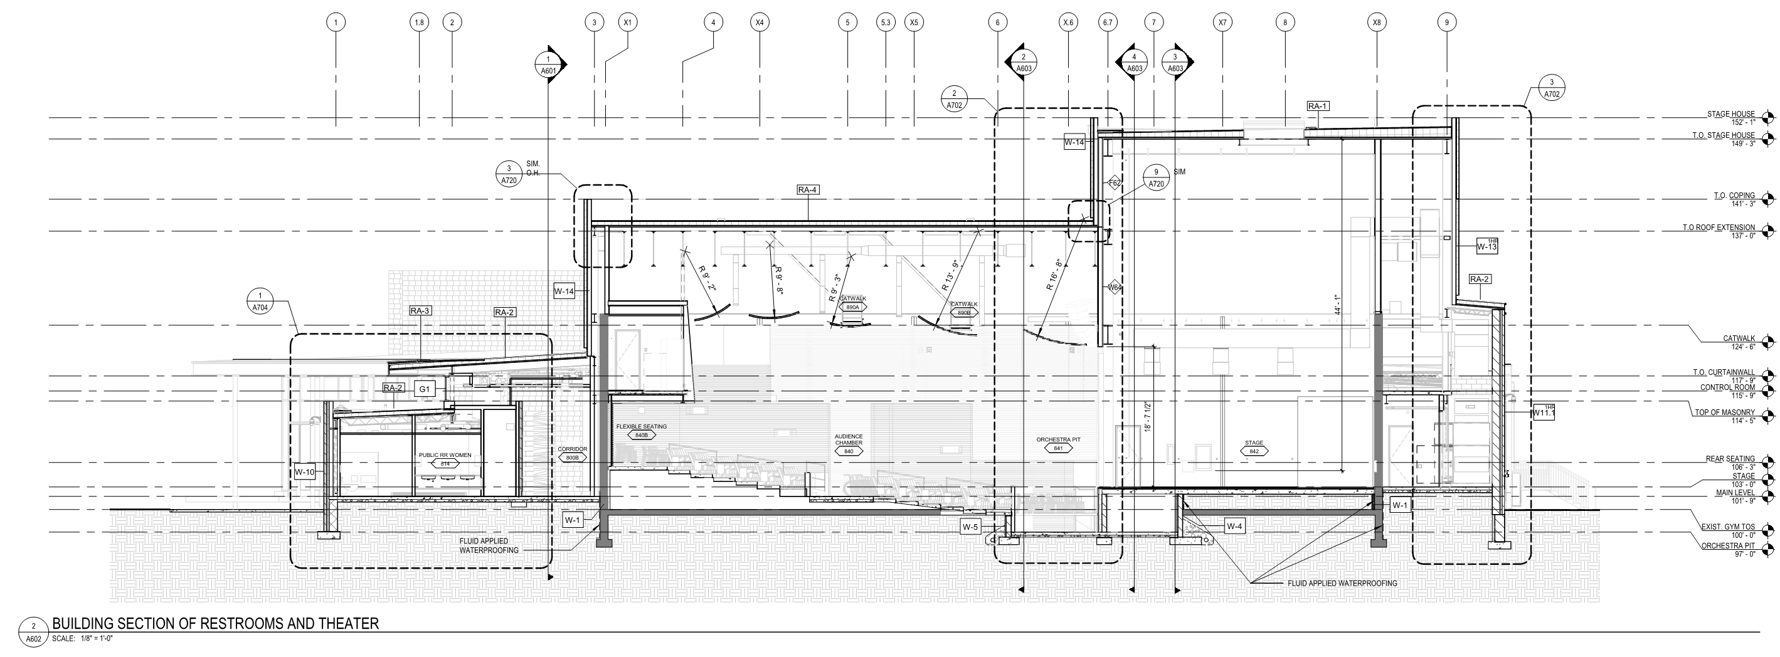
Technical Requirements – Theater

Slide 19
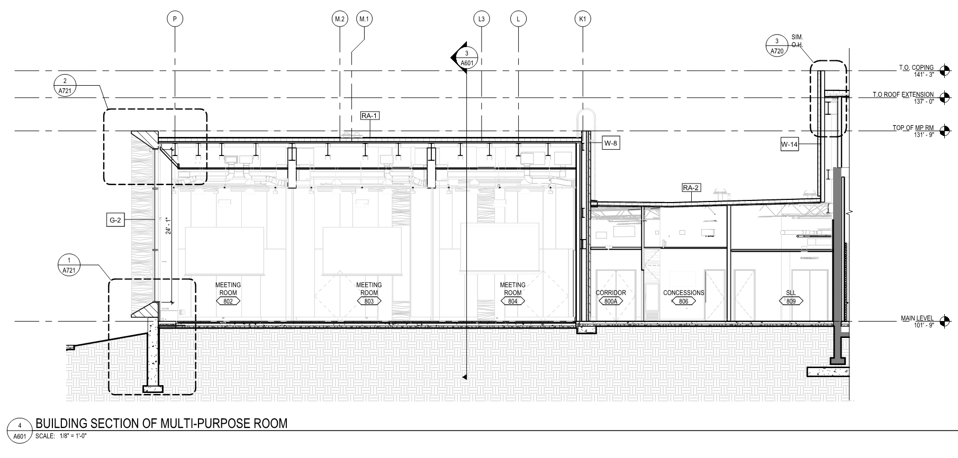
Technical Requirements – Multi-Purpose

Slide 20
Technical Requirements
LEED v4
Commissioning

Slide 21
Items of Note
Garrett County Weather
Bedrock

Slide 22
Walk Through
Questions from Walk Through

Slide 23
Contract Process & Award
Addendum #1 Issued from Meeting Questions
Dec. 4 noon RFI Deadline GCCEPAC@GarrettCollege.edu
Dec. 10 Addendum Issued
Dec. 17 2:00 Bids Due
      Bid Opening & Low Bidder Meeting
Dec. 20 Letter of Intent
February Contract Award & Notice to Proceed

Slide 24
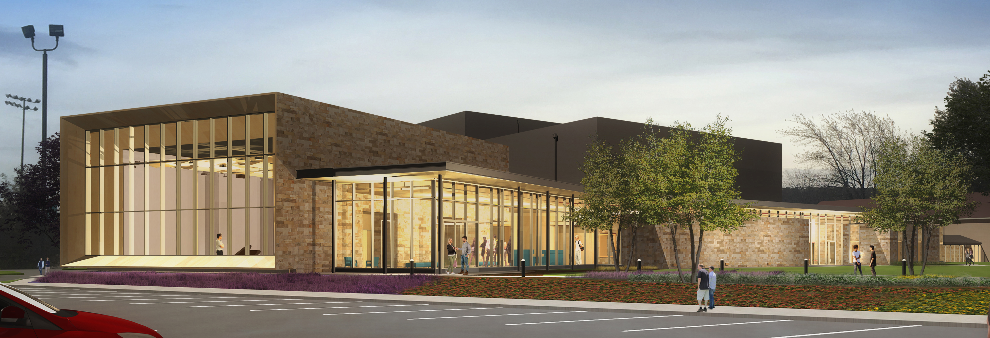
Questions / Information
GCCEPAC@GarrettCollege.edu
http://www.garrettcollege.edu/CEPAC

